Slide 1

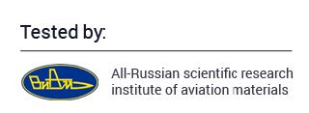
ANTI RADIATION CELL PHONE CASE
APRON-C REFLECTS UP TO 98% of RADIATION!
www.doctorfinkel.co.uk

Slide 2
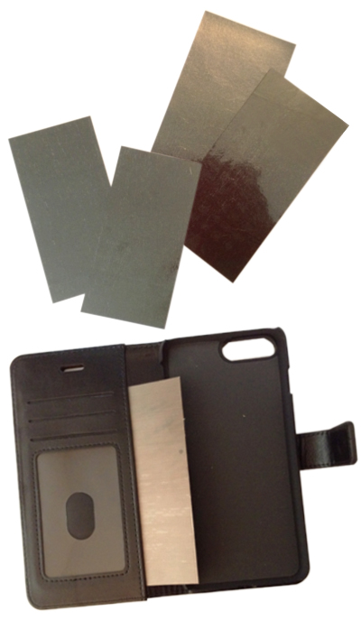

Apron-C
Anti-radiation material Apron-C in our every case
All our cases are equiped with unique anti-radiation material Apron-C that protects the device user by 98% from the hazardous effect of cellular radiation.
APRON-C REFLECTS
UP TO 98%* of RADIATION!
* in some models
Notes:
2

Slide 3
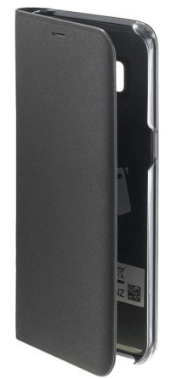
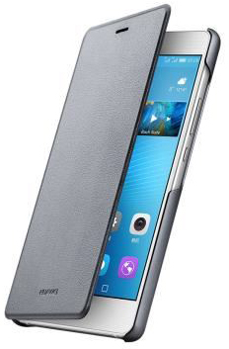
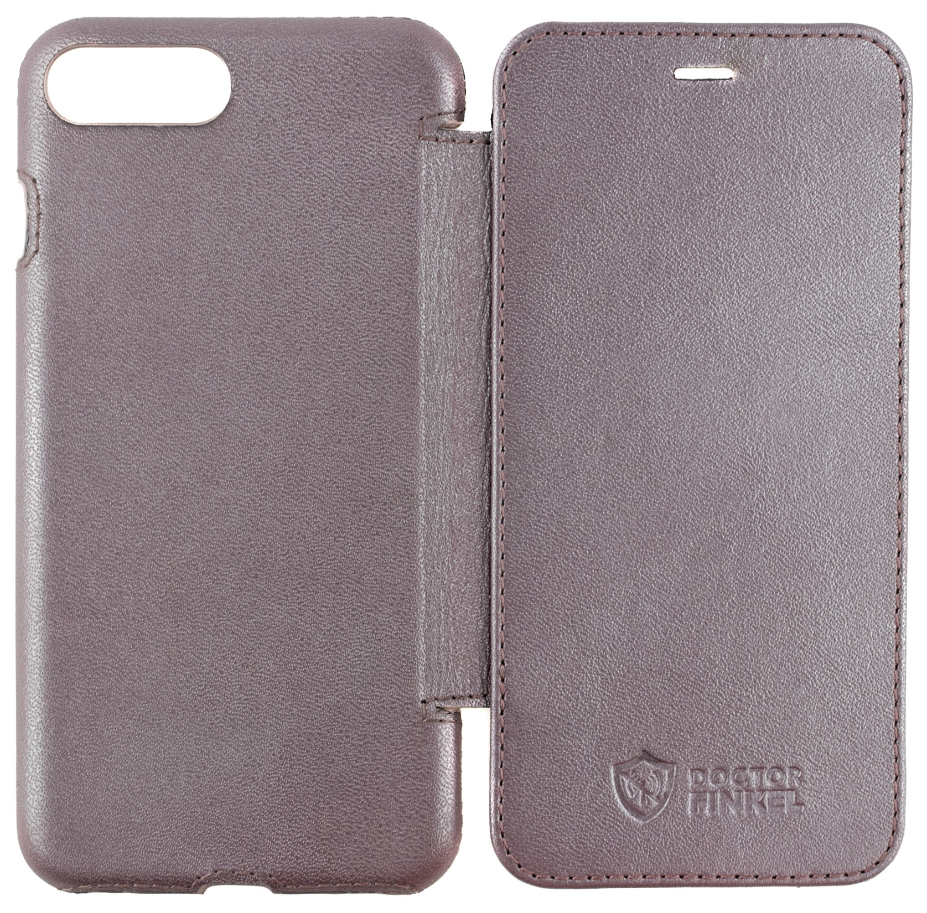
Booklet Classic
Samsung Galaxy 8
iPhone 7 Plus
Huawei P9 lite
APRON-C REFLECTS
UP TO 98%* of RADIATION!
* in some models
Notes:
3

Slide 4
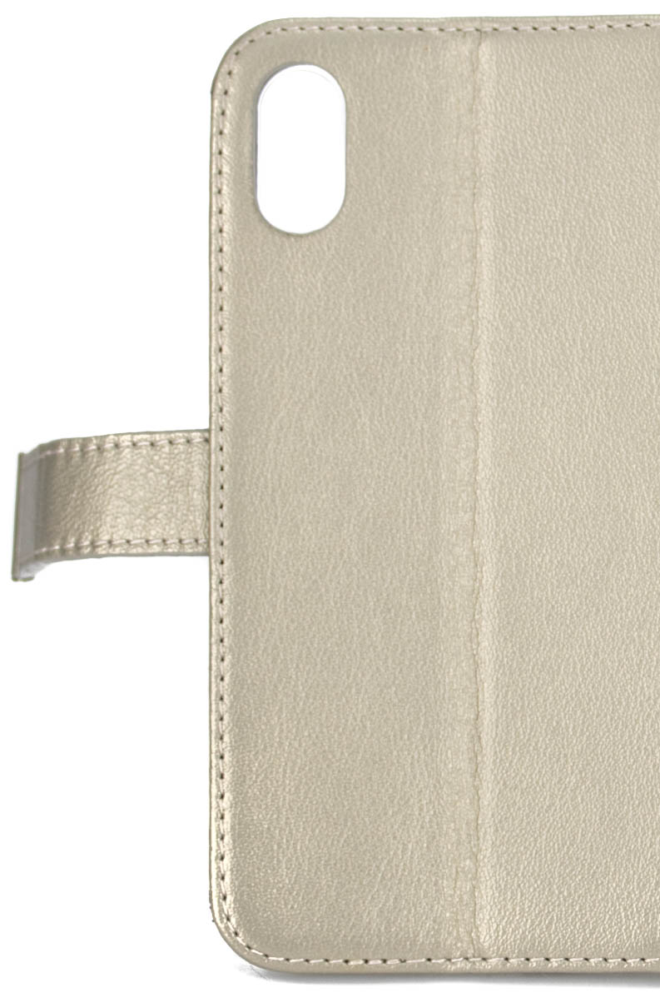
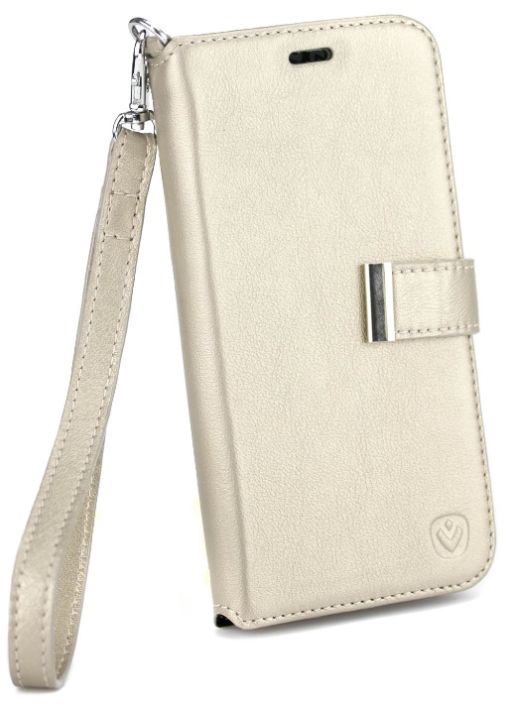
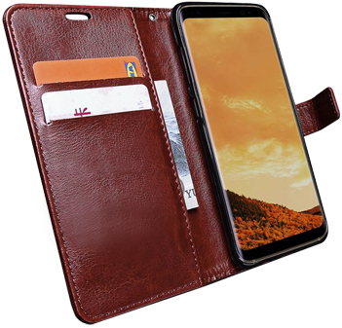
Booklet Premium
iPhone X/10
Samsung Galaxy 8
APRON-C REFLECTS
UP TO 98%* of RADIATION!
* in some models
Notes:
4

Slide 5
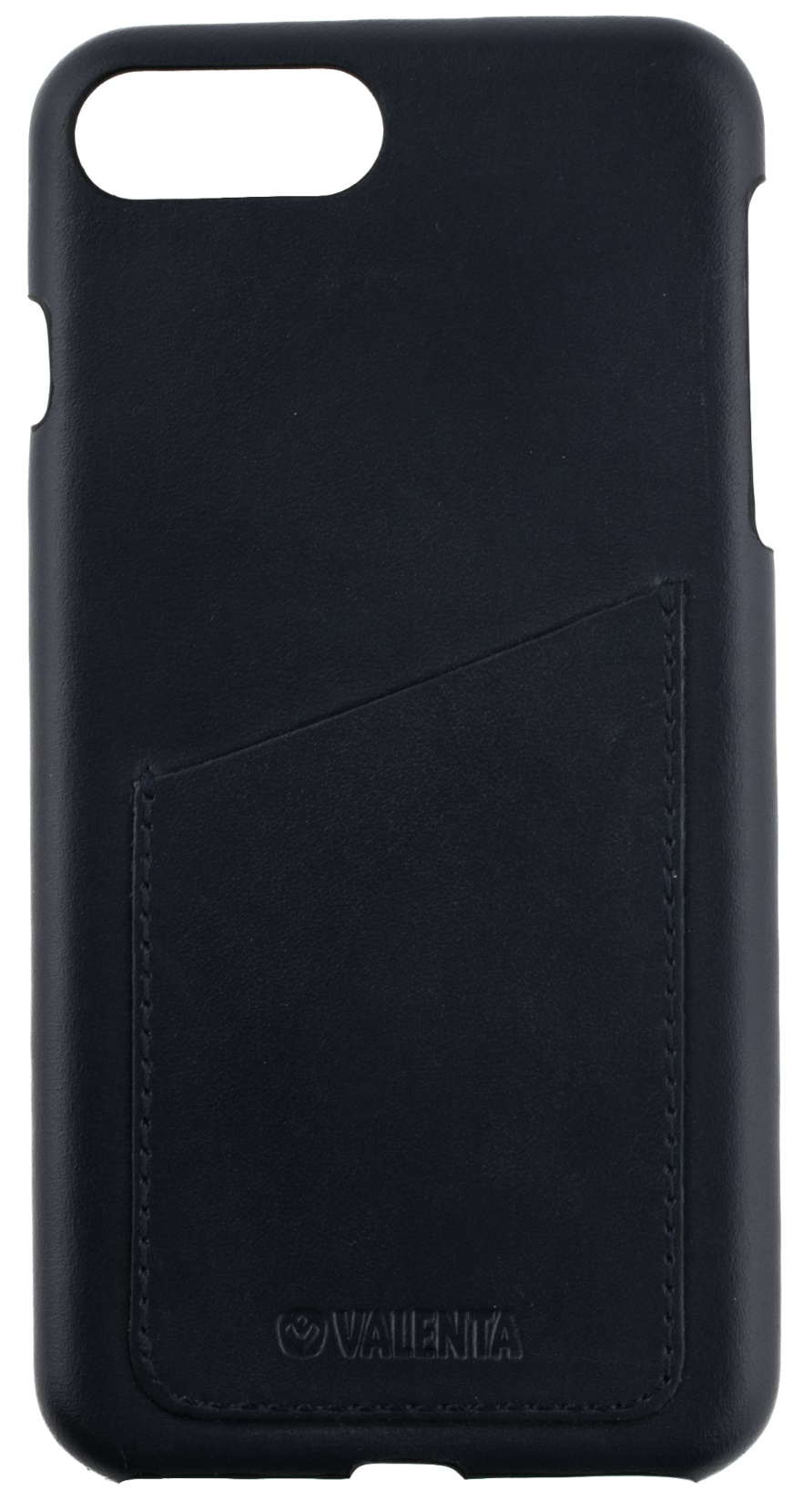
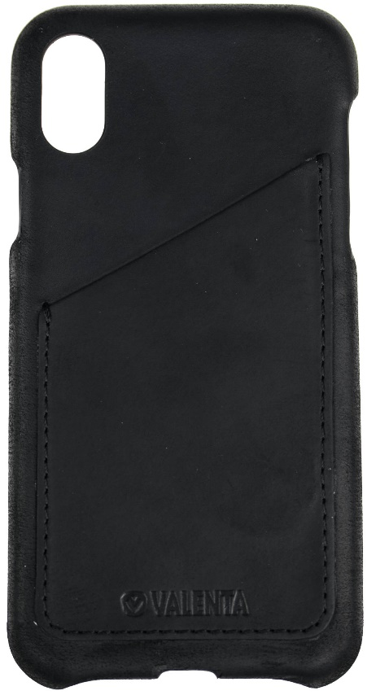
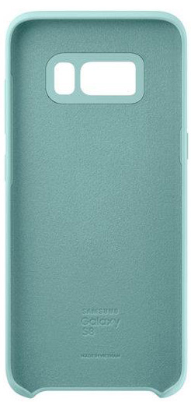
Back Cover Cases Classic
iPhone X/10
Samsung Galaxy 8
iPhone 7 Plus
APRON-C REFLECTS
UP TO 98%* of RADIATION!
* in some models
Notes:
5

Slide 6
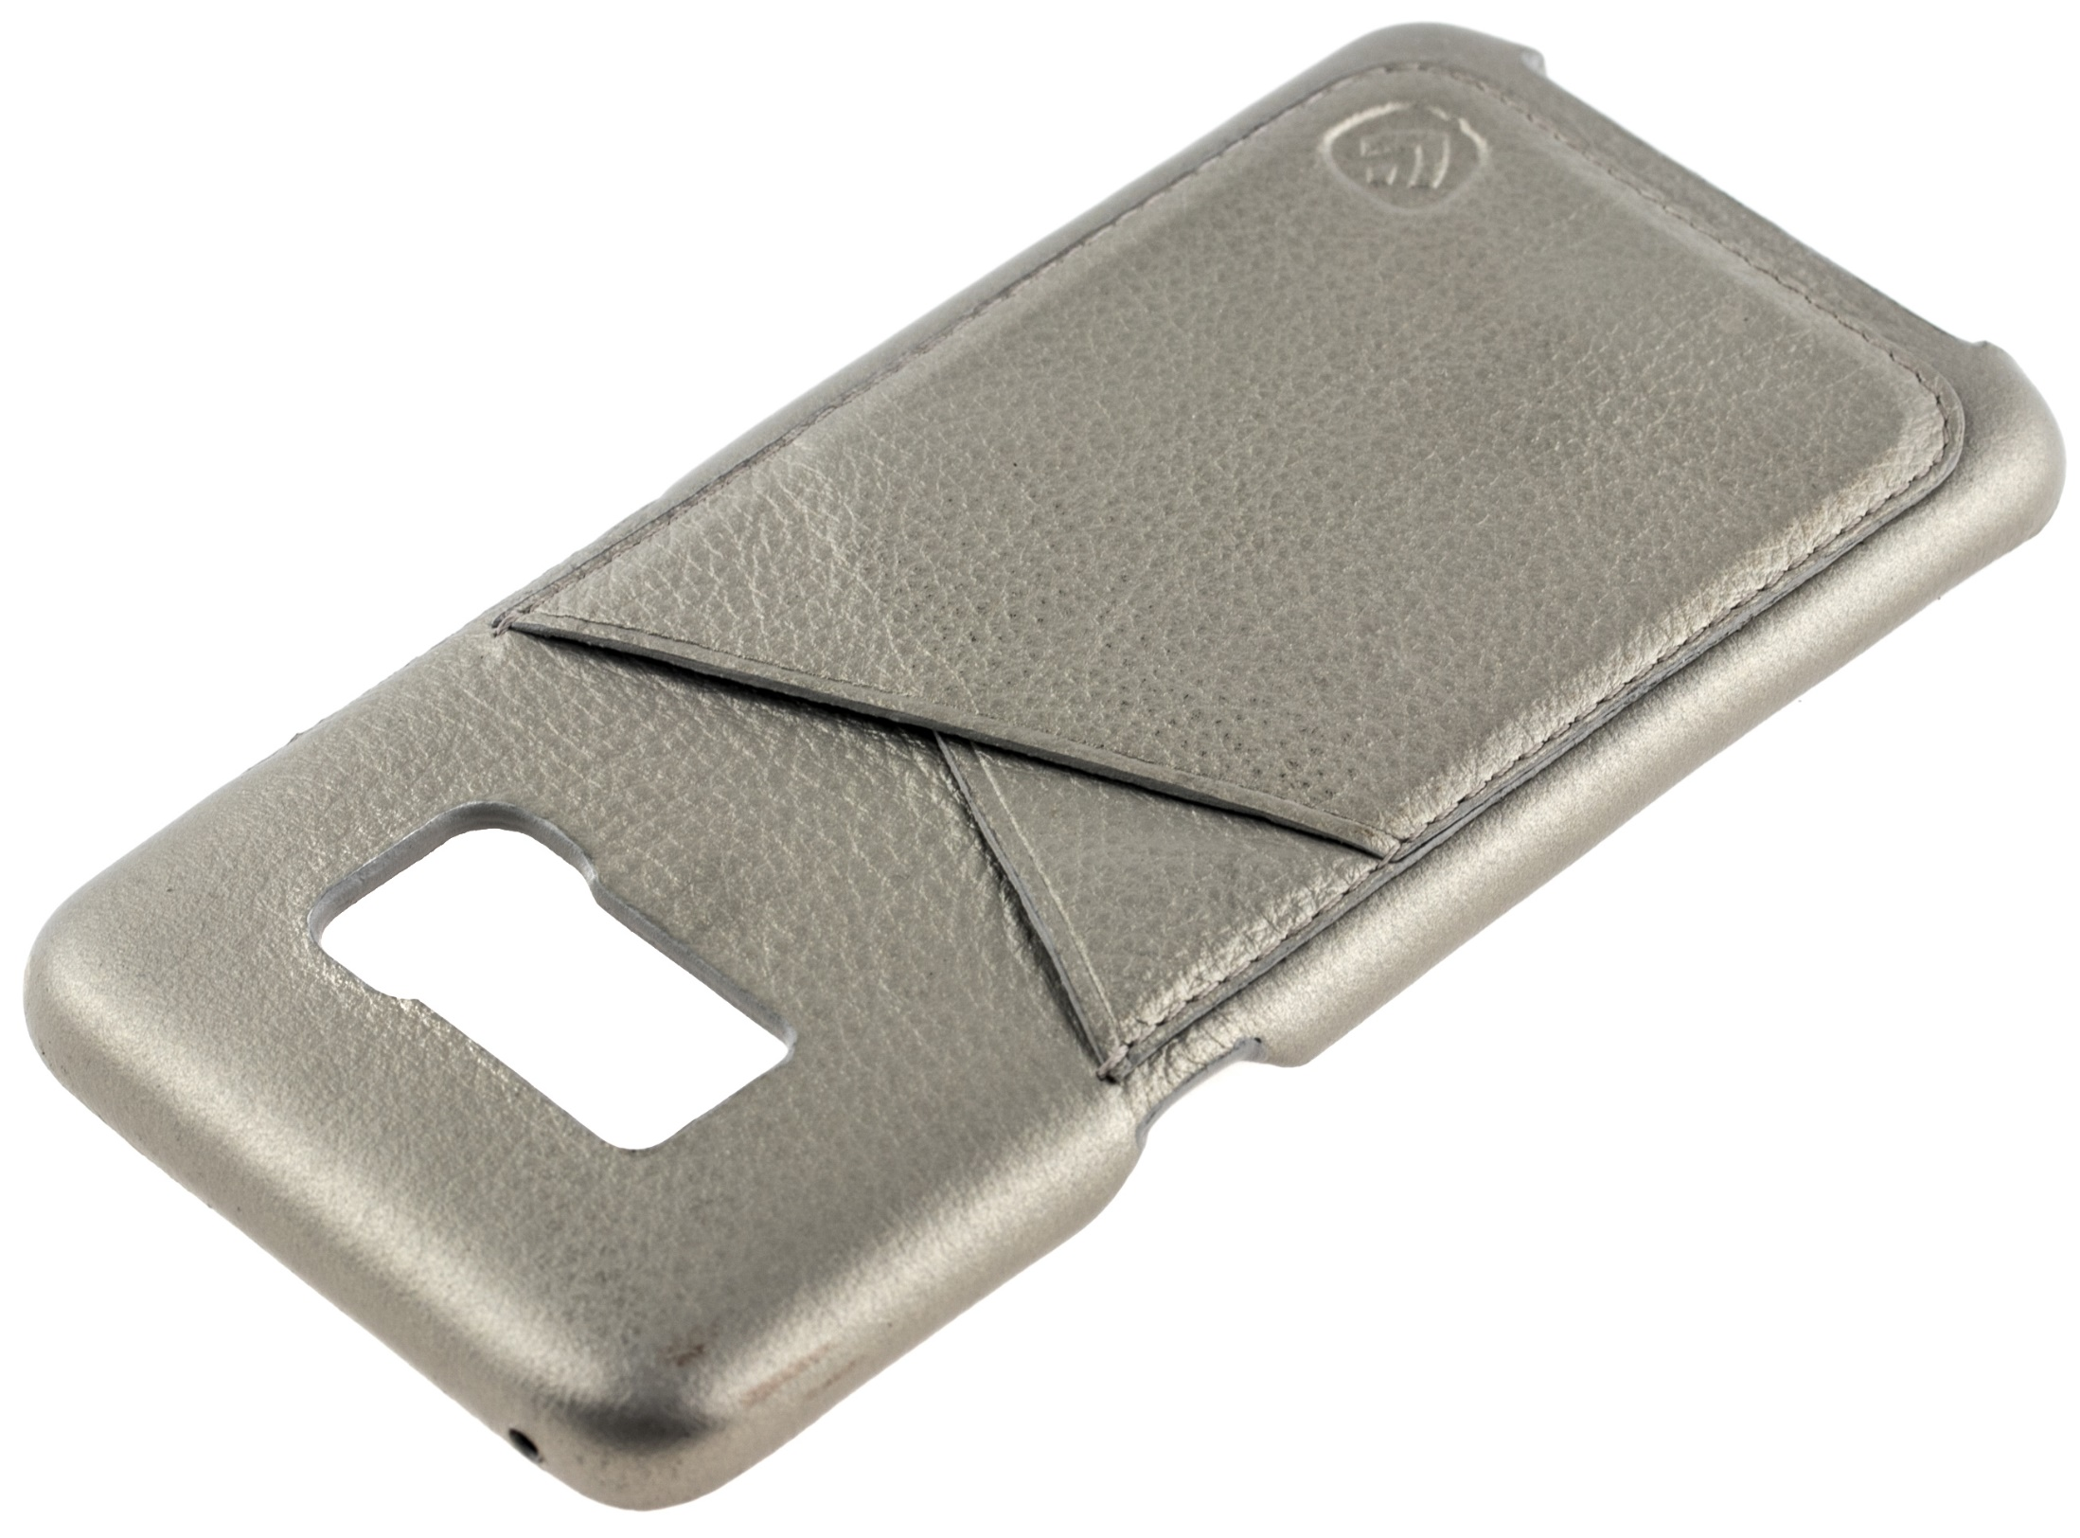
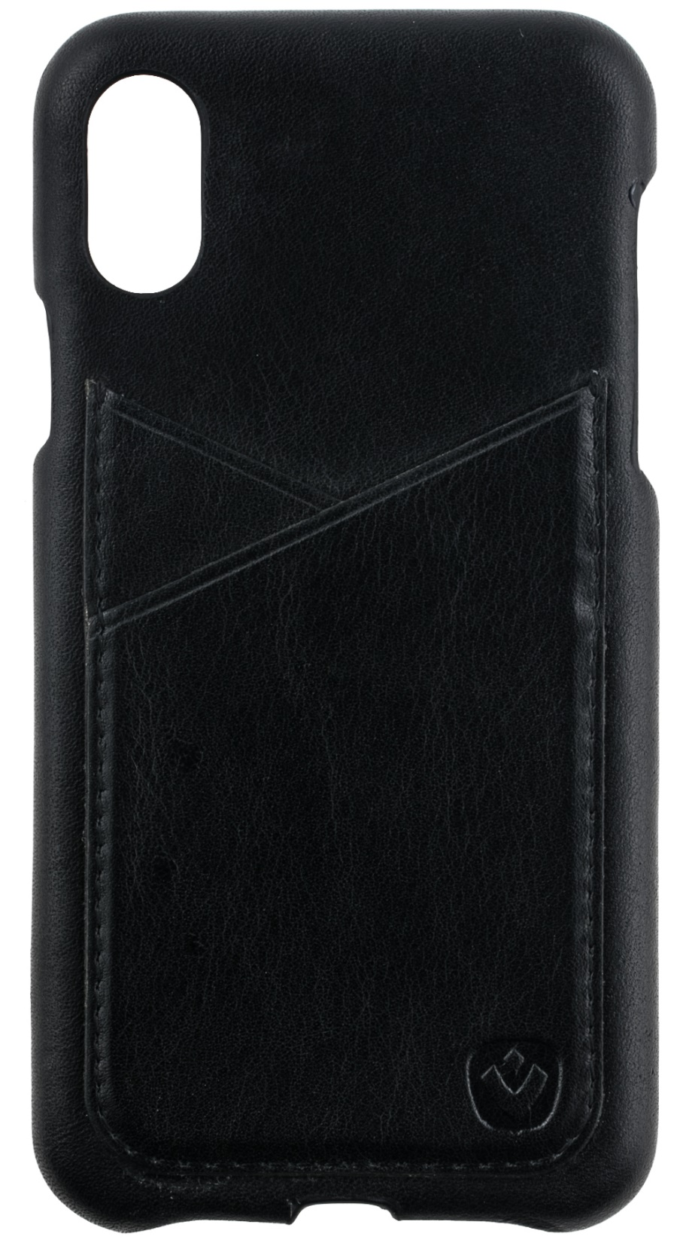
Back Cover Cases Premium
iPhone X/10
Samsung Galaxy 8
APRON-C REFLECTS
UP TO 98% of RADIATION!
* in some models
Notes:
6

Slide 7
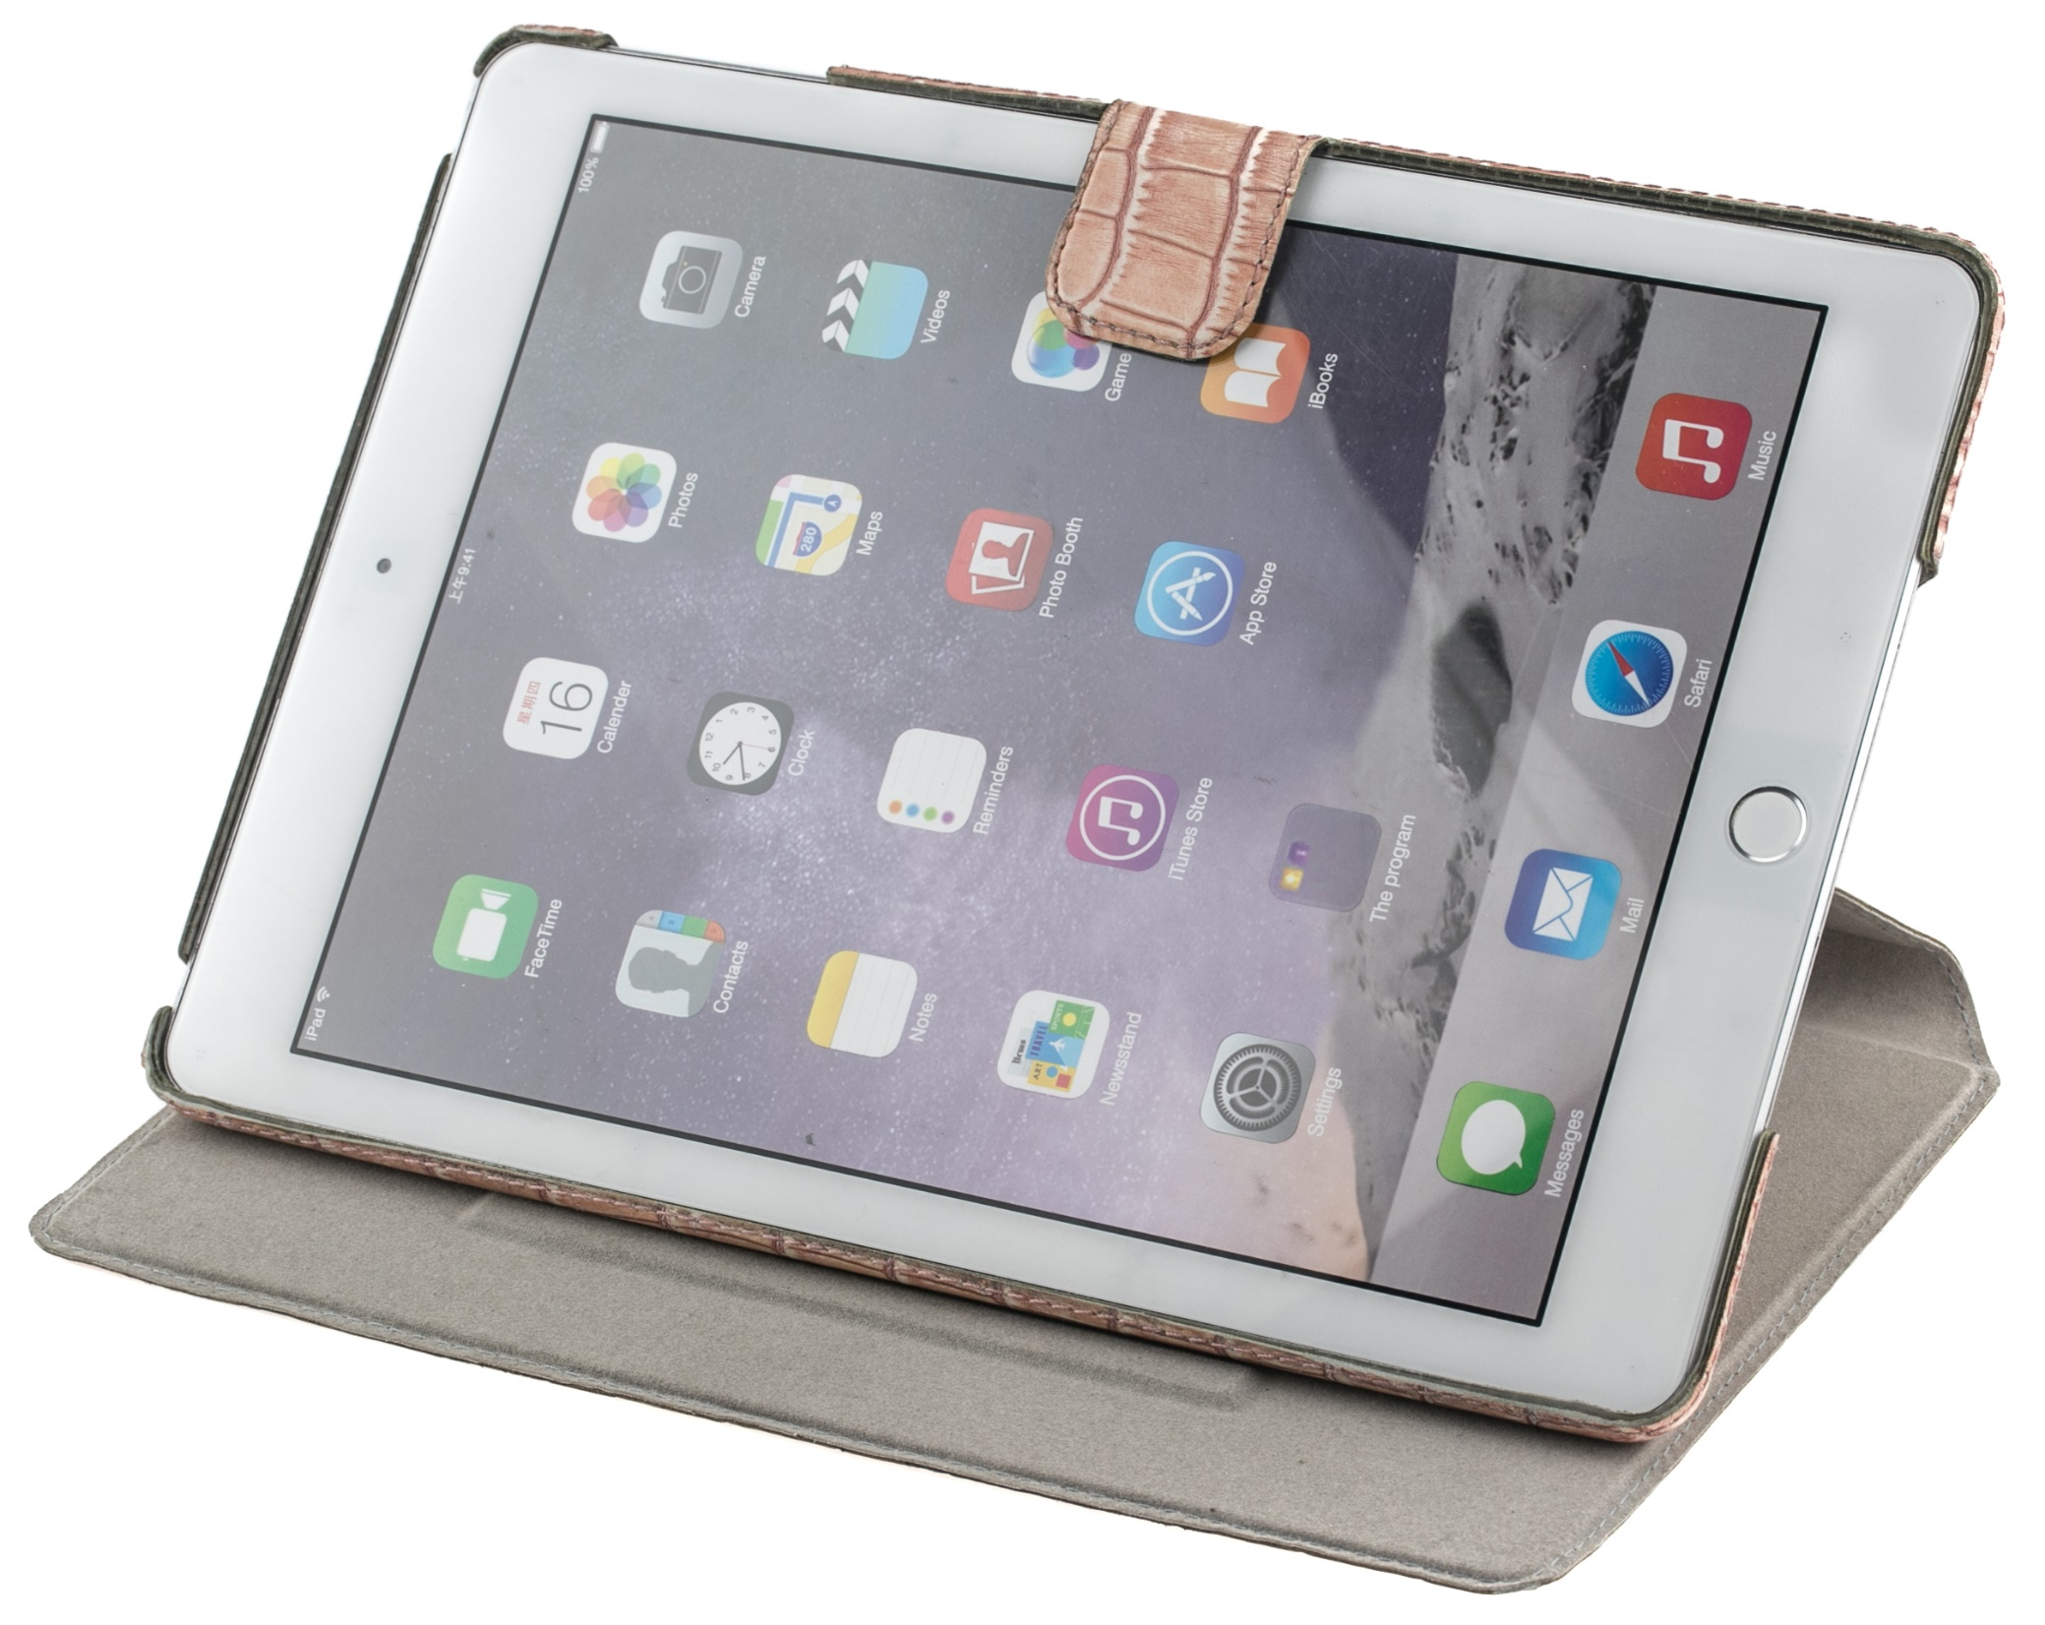
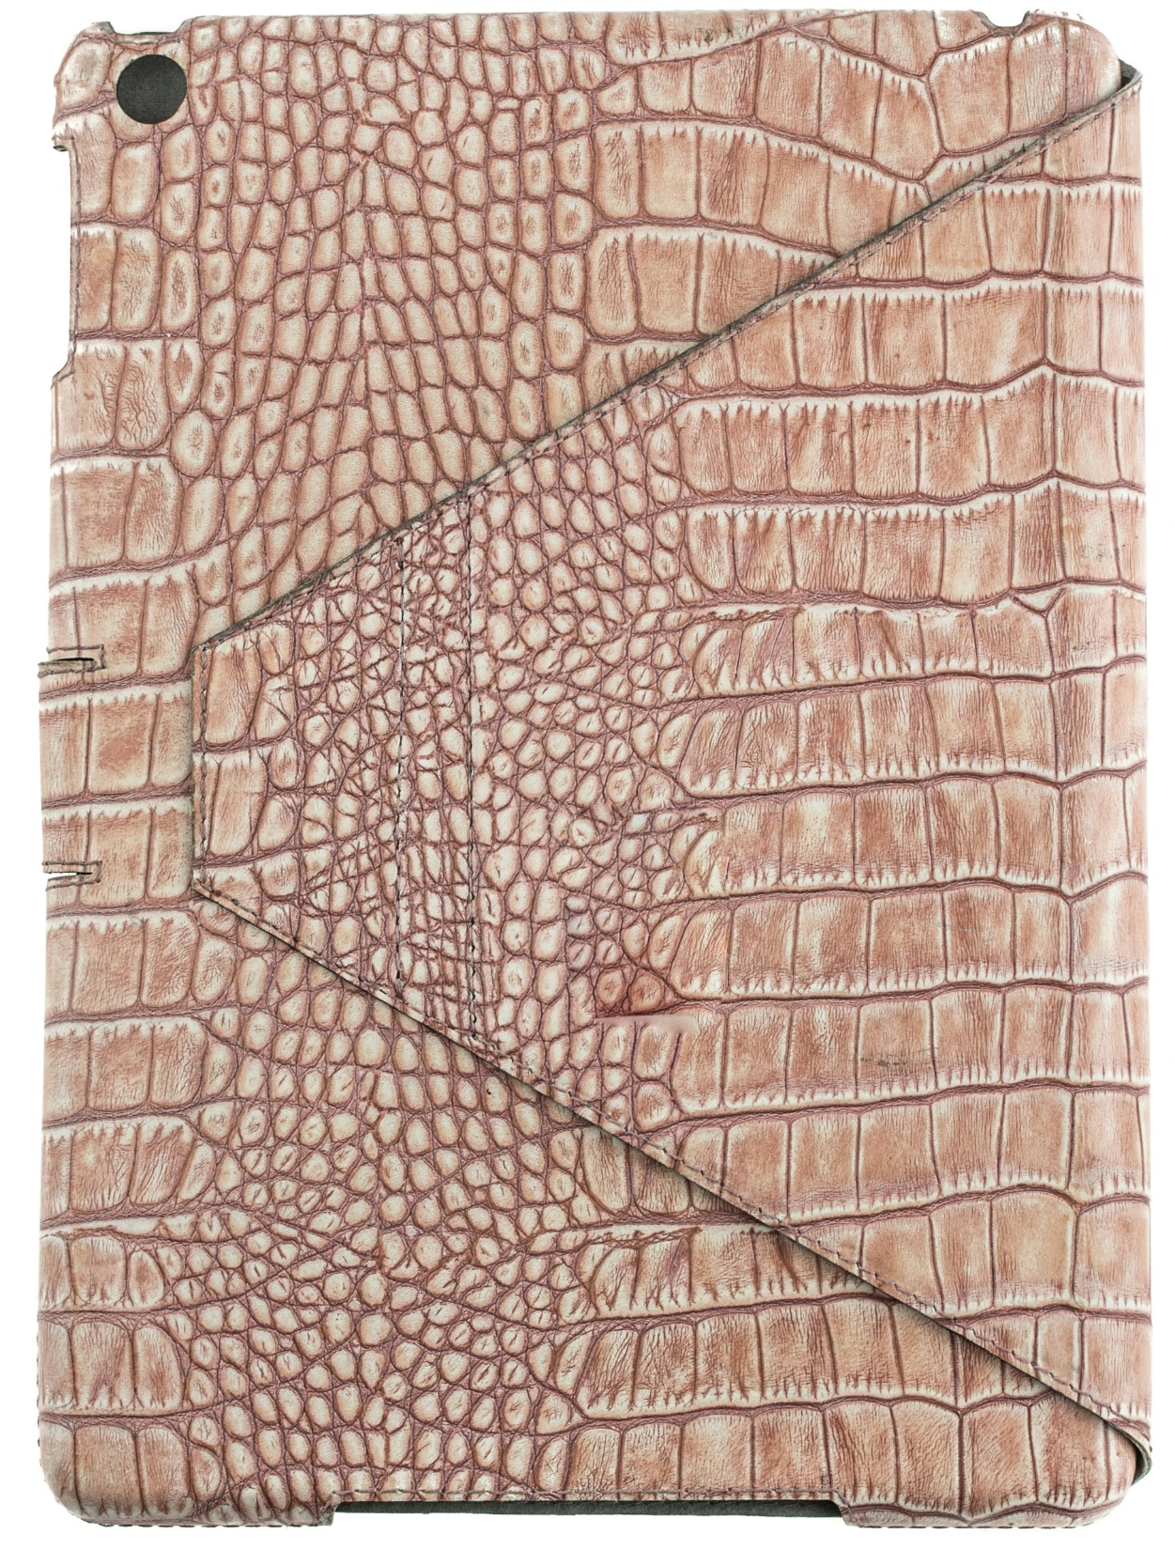
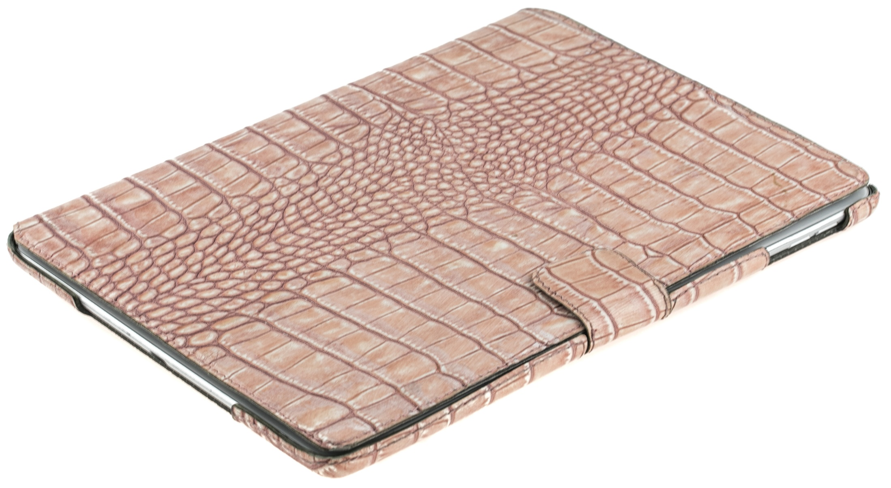
Tablet Cases
iPad PRO
APRON-C REFLECTS
UP TO 98% of RADIATION!
* in some models
Notes:
7

Slide 8
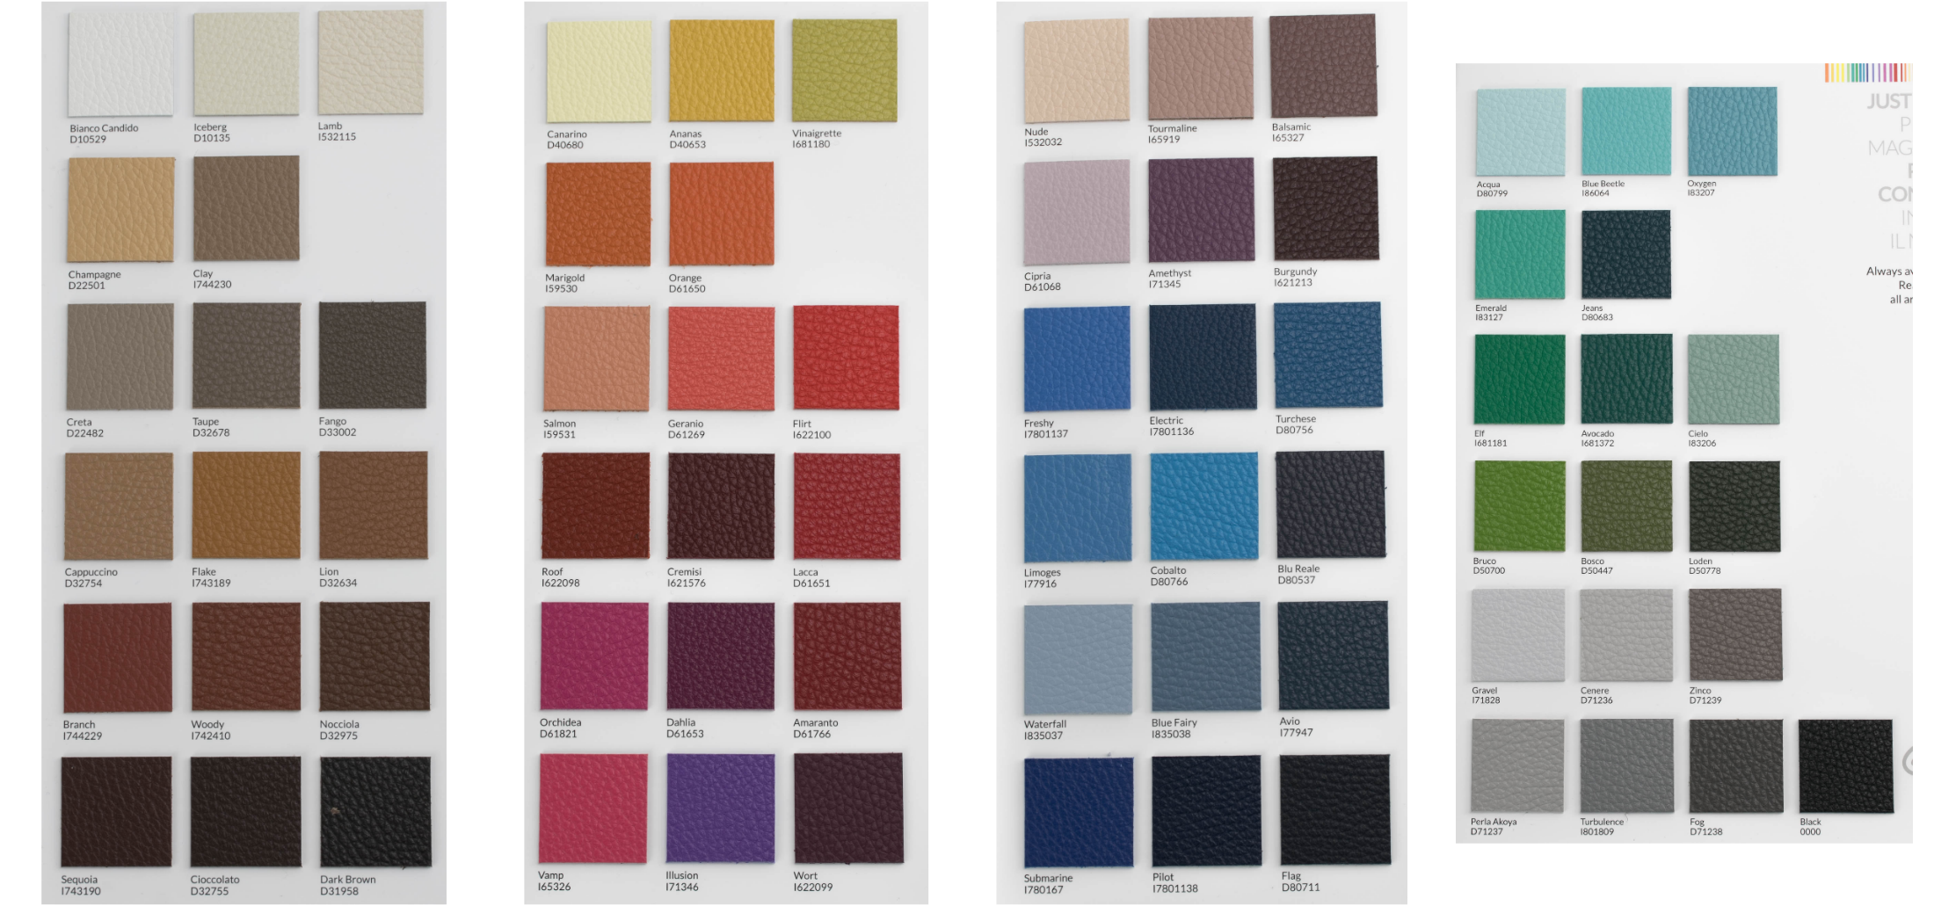
Leather - 1
APRON-C REFLECTS
UP TO 98% of RADIATION!
* in some models
Notes:
8

Slide 9
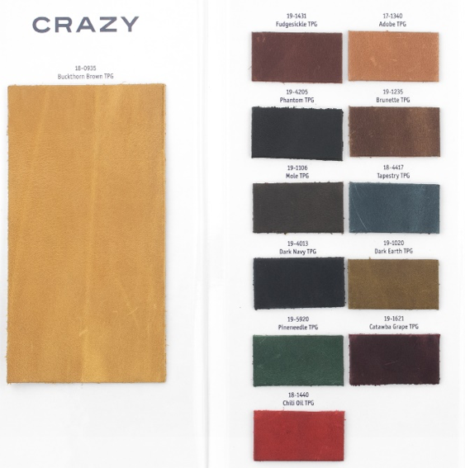
Leather - 2
APRON-C REFLECTS
UP TO 98% of RADIATION!
* in some models
Notes:
9

Slide 10
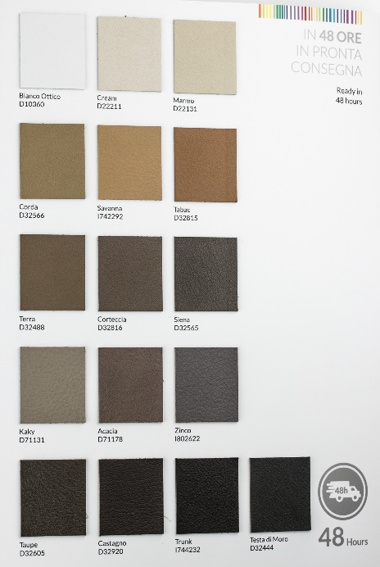
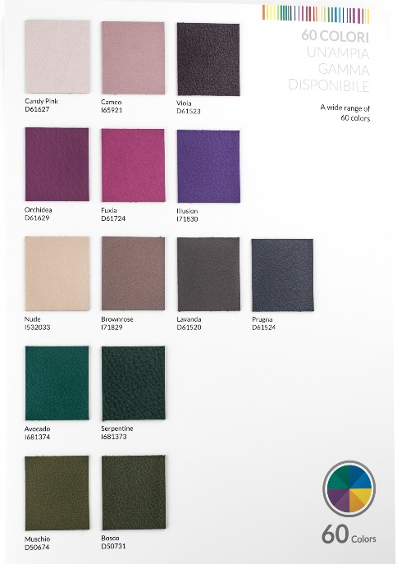
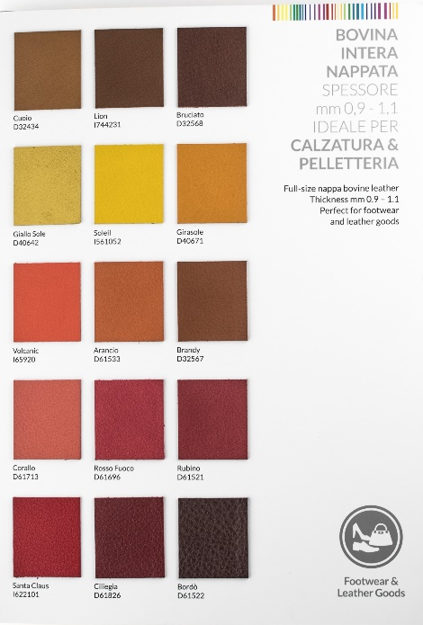
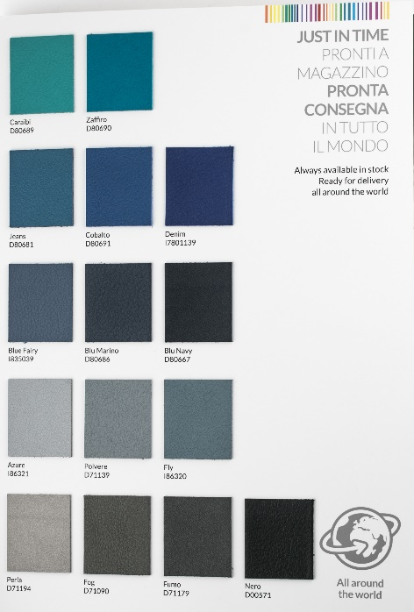
Leather - 3
APRON-C REFLECTS
UP TO 98% of RADIATION!
* in some models
Notes:
10

Slide 11
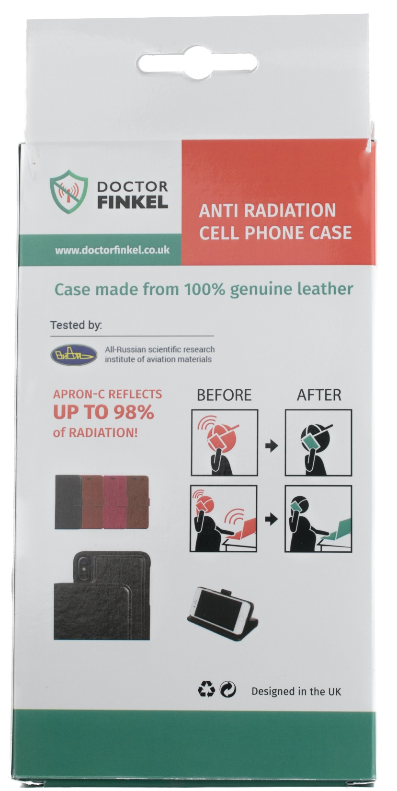
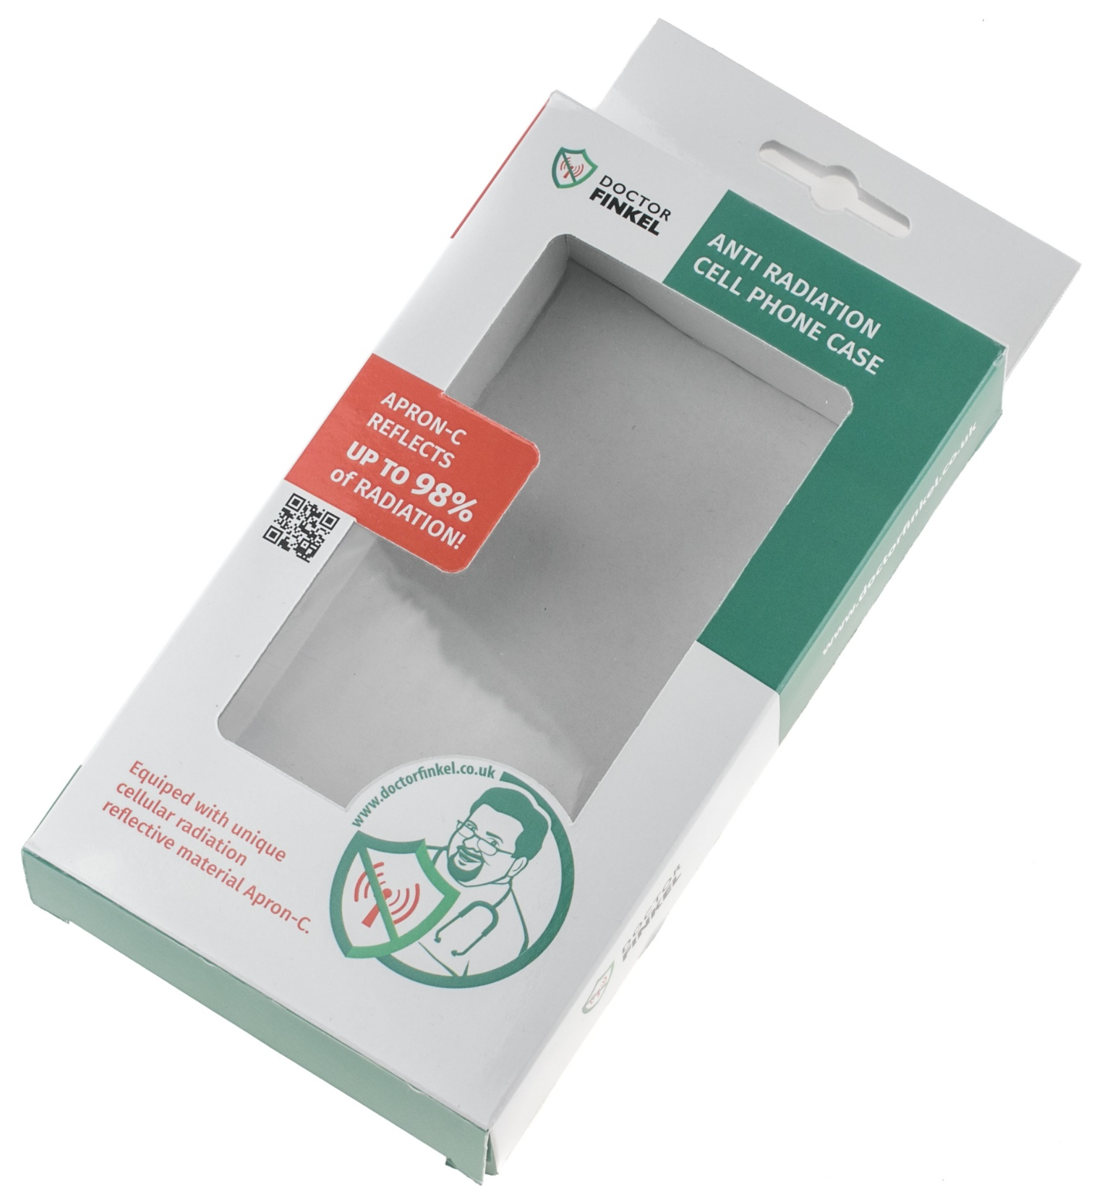
Box
APRON-C REFLECTS
UP TO 98% of RADIATION!
* in some models
Notes:
11

